Slide 1


Welcome to
Burleigh Reception
What is EYFS?

Slide 2
Burleigh Staff
Head Teacher | Mr Norman
Deputy Head Teacher | Miss Maxwell
Early Years Leader | Mrs Lovelock
Reception Teachers | Miss Osejindu, Mrs Martin, Mrs Marino
Reception TAs | Ms Daley, Mrs Christodoulou and Ms Finnigan

Slide 3
This PowerPoint is….
To help you to understand the curriculum that your child will be covering in Reception.
To understand how we teach in order to cover the requirements of the curriculum.
To help you to understand our form of assessments
To identify the key ways in which you can help your child at home and in school.

Slide 4
What is the Early Years Foundation Stage?
The Early Years Foundation Stage (E.Y.F.S.) is the stage of education for children from birth to the end of the Reception year.
It is based on the recognition that children learn best through play and active learning.

Slide 5
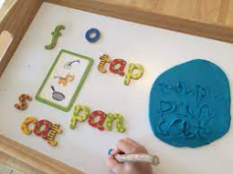
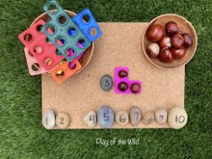
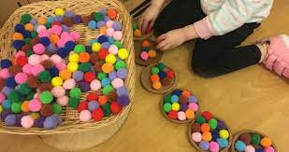
Reception Timetable
Early work/ Fine motor skills
Phonics groups
Snack
C.H.I.L – inside and outside
Maths
Lunch
TOPIC
PE
Music
C.H.I.L- inside and outside
Story / songs
Home Time

Slide 6

Topics for the Year

Slide 7
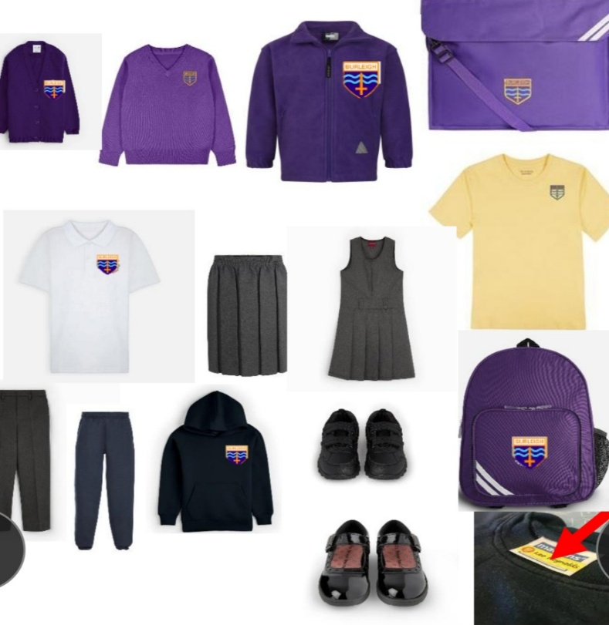
Routines and Procedures
Uniform- all named please
Outdoor – coats, wellies, sun cream, hats
Water bottles – named and water only, no juice
Book Bag brought to school every day
Hair – tied back
Jewellery - small studs only
Medical – anything we need to know
Collecting children at home time
Dinners

Slide 8


What is the EYFS?
Early Years Foundation Stage is the National Curriculum for children in Nursery and Reception.
There are 3 Prime areas of learning:
Communication and Language.
Physical Development.
Personal Social and Emotional Development.
There are 4 Specific areas of learning:
Literacy
Mathematics
Understanding the World
Expressive Arts and Design
All areas of learning are reflected inside and outdoors

Slide 9
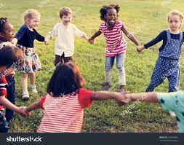

PSED
Personal, Social and Emotional Development
Making friends
Learning rules
Learning daily routines
Learning about other
cultures and respect
Understanding boundaries
Making good
relationships with adults

Slide 10

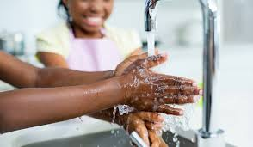
PSED - How can you help?
You can help by encouraging your child to use the toilet independently, wash their hands.
Put on and fasten their coats, clothes and shoes.
Eat with a knife and fork.
Playing games which encourage sharing and turn taking will help your child to build their social skills.

Slide 11
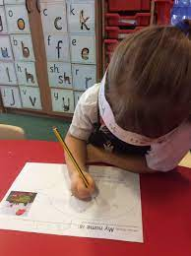
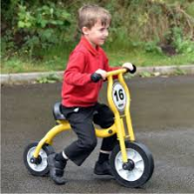
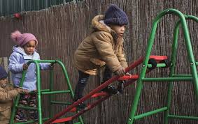
PD
Physical Development
Gross and fine motor skills
Malleable resources (play dough and construction kits)
Fasten shoes and coats
Outdoor area, climbing frame
Pencil control

Slide 12
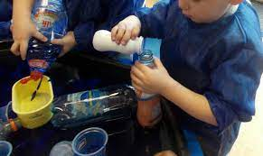
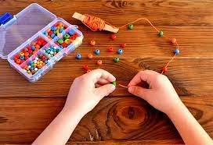
Physical Development
How can you help?
Give children time to run, jump, climb and play outdoors.
Encourage children to take part in activities such as building, drawing, threading beads, or filling and emptying containers in the water.

Slide 13
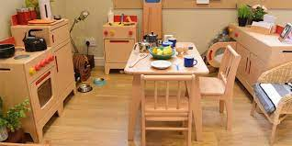


CL
Communication and Language
Stories
Speaking
Listening
Role play
Singing

Slide 14




CL – How you can help?
Singing songs and nursery rhymes
Taking time to listen to them talking
about things they’ve done and answering
their questions.
Share books together everyday.
Visit the library for story sessions.
Asking for well-known stories to be retold in your child’s own words.

Slide 15


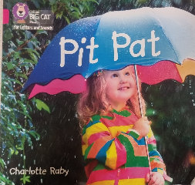
L - Literacy
Comprehension, Reading and Writing
Phonics (Letters and Sounds)
Reading books and retelling stories
Learning vocabulary
Recognising and writing own name
Key reading and writing words
Reading books and labels
Independent mark-making.

Slide 16
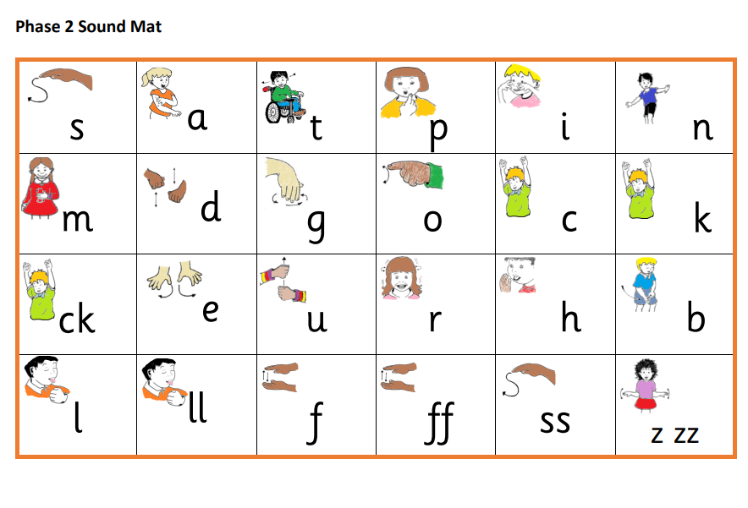
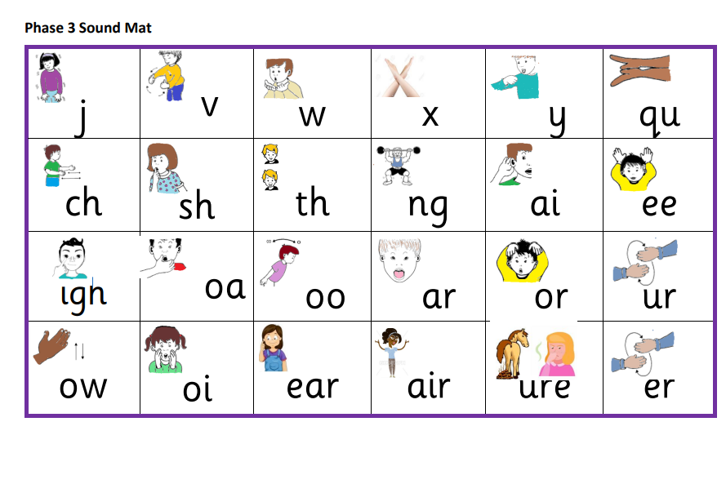

Slide 17


Literacy –
How can you help?
Encourage formation of lower case and capital letters to write name and all letters of the alphabet.
Reading a range of books (stories, information books, newspapers, magazines, comics etc), encouraging your child to join in and talk about books.
Read daily and write comments about your child’s
reading in their school reading diary.
Teach the letter ‘sounds’ known as phonemes to blend words together.

Slide 18

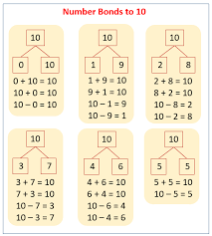
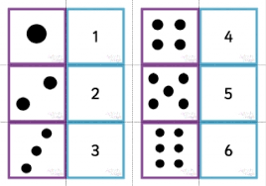
M - Mathematics
Counting
Subitising up to 5 (recognising
quantities without counting)
Recognising and ordering
numbers to 10
Number bonds to 10
Patterns within number
e.g. even and odd, halving, doubling, skip counting
Shape
Measuring

Slide 19


Mathematics–
How can you help?
Counting, adding and subtracting anything and everything – counters, cubes, socks, cars, shopping, cutlery, fingers and toes!
Talk about the shapes you can see in the environment
Comparing things which are heavy and light or long and short
Pointing out numbers all around
Singing counting songs and rhymes

Slide 20
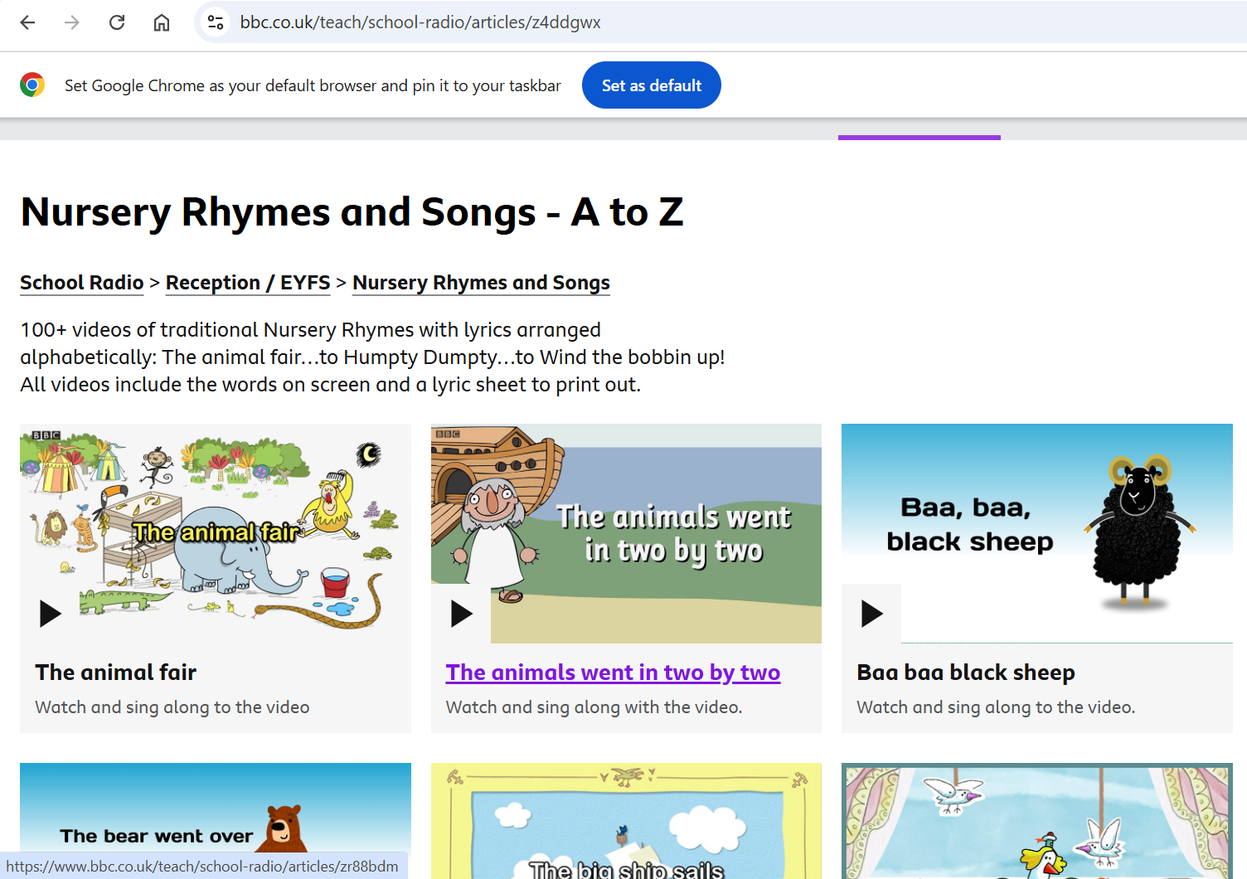

Slide 21

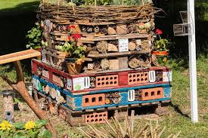
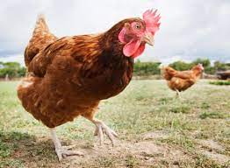
UW - Understanding the World
Exploring and investigating
Learning about other cultures, places, things that happened in the past and living things
Learning about similarities and differences
Learning about their local area
Learning about the lives of people around them
Outdoor area

Slide 22



Understanding
the World – How can you help?
Talk with your child about the places they go and things they see in the world around them
Answering and asking questions - what if…? Why do you think…? How did you…?
Letting children join in with everyday activities - washing up, cooking, shopping, helping in the garden...

Slide 23
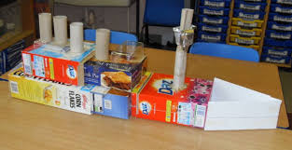
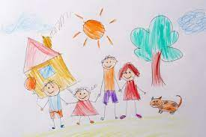
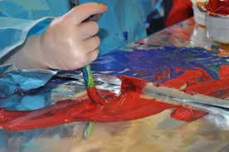
EAD
Expressive Arts and Design
Role play
Art
Painting
Drawing
Dance
Music
Singing
Story
Imagination

Slide 24

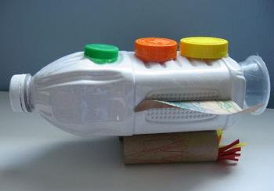
Expressive Arts and Design– How can you help?
Talk with your child about their imaginative play and join in if possible!
Encourage them to be flexible in their thinking and use of
materials and praising them for their efforts or ideas as well as the end product
Singing songs

Slide 25

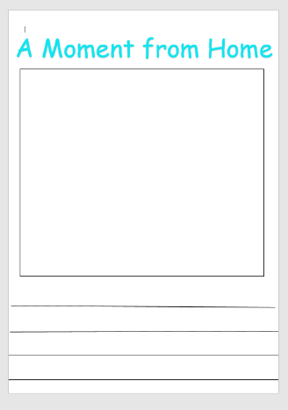

Documenting learning

Slide 26
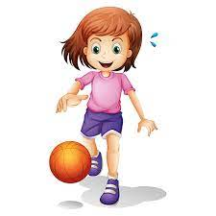
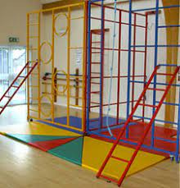

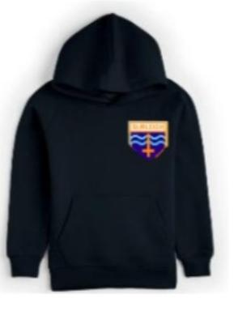
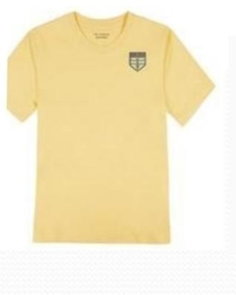
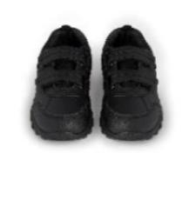
P.E
P.E. will be on a Thursday afternoons. On this day your child should come to school wearing their PE kit.
All jewellery needs to be removed and trainers or plimsolls should be worn. Children are permitted to wear a plain blue hoodie or PE without the Burleigh embroidered logo. Please ensure trainers are Velcro and not laces.

Slide 27
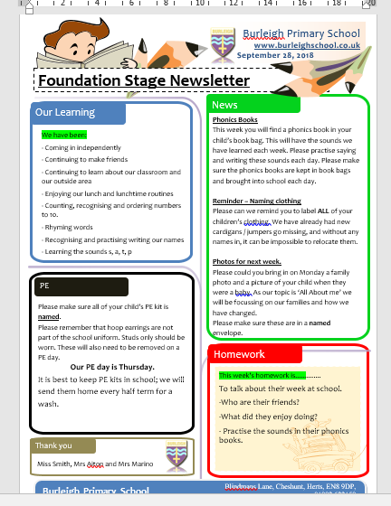
Weekly Newsletter

Slide 28
How to Contact Us
At the classroom door:
We are very happy to discuss any questions or issues you may have at the classroom door. The best time to do this is at the end of the school day.
Speak to Mr Norman, Ms Maxwell or Ms Mansi
They are on the school gates daily
Contact the office
Phone or email the school office and they will pass any messages to us
Contact the SENCO
Contact Mrs Collins by email (senco@burleigh.herts.sch.uk) or via the school office. She works on a Monday, Tuesday and Wednesday.

Slide 29

Communicating with you.
You can click on this link to download the app
https://login.schoolgateway.com/0/auth/login

Slide 30

School Website
Every year group has its own section on the school website.
In here you will find:
Information about the year group, including this PowerPoint
Weekly Newsletter – overview of weekly learning
Our Work – photos of work completed in class or trips and workshops
Phonics – information to help you support your child
Useful Information – signposts to useful websites or resources
Letters specific to EYFS

Slide 31


Wellbeing Award
We are aiming to achieve the award by April 2027
What will we be doing this term:
Wellbeing Newsletter:
Published every half-term, to provide you with information about how we are supporting your children’s wellbeing in school and helpful ideas about how you can continue to support your children at home
Introduction of ‘Wellbeing Ambassadors’:
Children in Years 3 to 6 are being trained to support each other on the playground
Introduction of ‘Zones of Regulation’ in all classes
Children will have a common language to use to discuss their feelings and emotions
What will we be doing this term:
Wellbeing Newsletter:
Published every half-term, to provide you with information about how we are supporting your children’s wellbeing in school and helpful ideas about how you can continue to support your children at home
Introduction of ‘Wellbeing Ambassadors’:
Children in Years 3 to 6 are being trained to support each other on the playground
Introduction of ‘Zones of Regulation’ in all classes
Children will have a common language to use to discuss their feelings and emotions

Slide 32


Date for Diaries
Reading Meeting
Wednesday 21st October 2026 - 2:30pm – 3.10pm
All you need to know to help support your child to read at home

Slide 33

Thank you for your time today.

